Slide 1
Comparing Linear Functions in Different Forms
Algebra I | Module 2 | Topic 2 | Lesson 4
1
Notes:
Note: Total suggested pacing for this lesson is two 45-minute sessions.

Slide 2
Objectives
Compare linear functions represented algebraically, graphically, in tables, or with verbal descriptions.
Choose and interpret appropriate units to represent independent and dependent quantities in situations modeled by linear functions.
Choose and interpret appropriate scales and origins for graphs of linear functions.
SE p. 319
2
Notes:
TEKS:
A.1A: apply mathematics to problems arising in everyday life, society, and the workplace.
A.1B: use a problem-solving model that incorporates analyzing given information, formulating a plan or strategy, determining a solution, justifying the solution, and evaluating the problem-solving process and the reasonableness of the solution.
A.1D: communicate mathematical ideas, reasoning, and their implications using multiple representations, including symbols, diagrams, graphs, and language as appropriate.
A.3A: determine the slope of a line given a table of values, a graph, two points on the line, and an equation written in various forms, including y = mx + b, Ax + By = C, and y − $y_{1}$ = m(x − $x_{1}$).
A.3C: graph linear functions on the coordinate plane and identify key features, including x-intercept, y-intercept, zeros, and slope, in mathematical and real-world problems.
A.12B: evaluate functions, expressed in function notation, given one or more elements in their domains.
ELPS:
1.D: speak using learning strategies such as requesting assistance, employing non-verbal cues, and using synonyms and circumlocution (conveying ideas by defining or describing when exact English words are not known).
2.G: understand the general meaning, main points, and important details of spoken language ranging from situations in which topics, language, and contexts are familiar to unfamiliar.
4.A: learn relationships between sounds and letters of the English language and decode (sound out) words using a combination of skills such as recognizing sound-letter relationships and identifying cognates, affixes, roots and base words.

Slide 3
Essential Question (1 of 2)
You have represented linear functions in a variety of different ways.
How does each linear function representation compare with
the others?
SE p. 319
3
Notes:
Setting the Stage:
Tap into your student’s prior learning by reading the narrative statement.
Provide a sense of direction by reading the Essential Question.

Slide 4
Day 1
1
4
Notes:
Note: Total suggested pacing for Day 1 is 45 minutes.

Slide 5
Getting Started
5–10
5
Notes:
Note: Total time of 5-10 minutes allotted for the Getting Started.

Slide 6
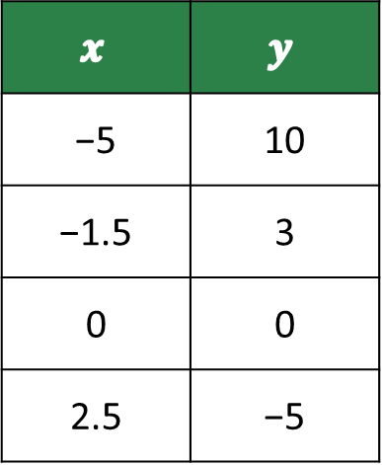
Odd One Out (1 of 4)
Choose the function that does not belong with the others and justify your choice.
Function A
Function B
$$x$$ | $$y$$
−5 | 10
−1.5 | 3
0 | 0
2.5 | −5
During one year at a high school, the ratio of 9th-graders to 10th-graders was 1 : 1.
SE p. 320
6
Notes:
Questions to Support Discourse – Probing:
Is there more than one correct answer? Explain.
What would a graph of this function look like?
How do the slopes of the functions compare?
Compare the y-intercepts of the functions.
What is different about the functions’ domains?

Slide 7
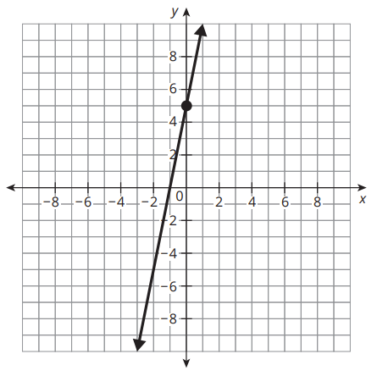
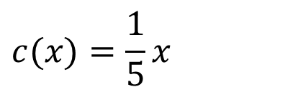
Odd One Out (2 of 4)
Function C
Function D
$$c(x)=\frac{1}{5}x$$
Sample answers: A (the table) is the only decreasing function (slope −2). D (the graph) is the only one whose y-intercept is not 0. C (the equation) is the only one with a slope between 0 and 1. B (the description) is the only one whose domain is whole numbers only.
SE p. 320
7
Notes:
Questions to Support Discourse – Probing:
Is there more than one correct answer? Explain.
What would a graph of this function look like?
How do the slopes of the functions compare?
Compare the y-intercepts of the functions.
What is different about the functions’ domains?
Any choice is correct if the justification is. Function B (ratio 1 : 1) has slope 1; Function D passes through (0, 5).

Slide 8

Odd One Out (3 of 4)
Let’s summarize our learning from the Getting Started!
SE p. 320
8
Notes:
Getting Started Summary:
Characteristics of functions can be determined using a variety of different function representations.

Slide 9
Odd One Out (4 of 4)
SE p. 320
9
Notes:
Note: This slide is blank for optional use with displaying work.

Slide 10
Activity 4.1
4.1
15–20
10
Notes:
Note: Total time of 15-20 minutes allotted for Activity 4.1.

Slide 11
Slopes of Linear Relationships (1 of 5)
Consider the line that represents the equation y = 4x − 3.
Determine whether the graph of each linear relationship is parallel, perpendicular, or neither parallel nor perpendicular to the graph of y = 4x − 3.
a.
b. An elevator descends 4 feet
every second.
  b. The slope is −4. Neither parallel nor perpendicular to y = 4x − 3.
x | y
−2.5 | −6
0 | 4
0.5 | 6
3 | 16
a. The slope is 4. Parallel to y = 4x − 3.
SE p. 321
11
Notes:
Questions to Support Discourse – Gathering:
How can you use the slopes of two lines to determine whether the graphs will be parallel or perpendicular?
Questions to Support Discourse – Probing:
Do you need to calculate the slope between each pair of points in the table? Explain your reasoning.
What sign did you use for the slope of the elevator? Why?

Slide 12
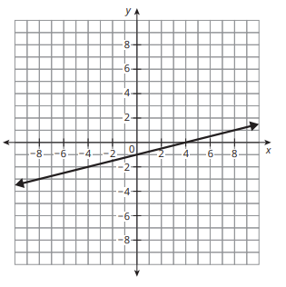
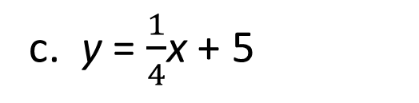
Slopes of Linear Relationships (2 of 5)
c. y = $\frac{1}{4}$x + 5
  c. The slope is 1/4. Neither parallel nor perpendicular to y = 4x − 3.
d.
d. The slope is 1/4. Neither parallel nor perpendicular to y = 4x − 3.
SE p. 321
12
Notes:
Questions to Support Discourse – Gathering:
How can you use the slopes of two lines to determine whether the graphs will be parallel or perpendicular?
Questions to Support Discourse – Probing:
Do you need to calculate the slope between each pair of points in the table? Explain your reasoning.
What sign did you use for the slope of the elevator? Why?

Slide 13
Slopes of Linear Relationships (3 of 5)
e.
f. For every hour Chiletso bakes, she makes 4 dozen cookies.
  f. The slope is 4 (dozen cookies per hour). Parallel to y = 4x − 3.
x | y
−4 | 3
0 | 2
2 | 1.5
8 | 0
e. The slope is −1/4. Perpendicular to y = 4x − 3, since 4 · (−1/4) = −1.
SE p. 321
13
Notes:
Questions to Support Discourse – Gathering:
How can you use the slopes of two lines to determine whether the graphs will be parallel or perpendicular?
Questions to Support Discourse – Probing:
Do you need to calculate the slope between each pair of points in the table? Explain your reasoning.
What sign did you use for the slope of the elevator? Why?

Slide 14
Slopes of Linear Relationships (4 of 5)
Let’s summarize our learning from Activity 4.1!
SE p. 321
14
Notes:
Activity 4.1 Summary:
The slopes of different representations of lines can be compared to determine whether the graphs of their lines are parallel or perpendicular.

Slide 15
Slopes of Linear Relationships (5 of 5)
SE p. 321
15
Notes:
Note: This slide is blank for optional use with displaying work.

Slide 16
Activity 4.2
4.2
10–15
16
Notes:
Note: Total time of 10-15 minutes allotted for Activity 4.2.

Slide 17
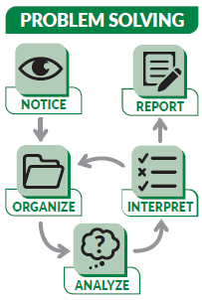
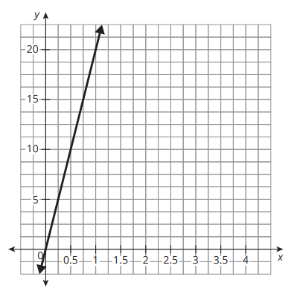
Comparing Tables and Graphs (1 of 5)
Large recycling centers pay out different amounts per ton of cardboard recycled. Travis County Recycling Center lists its payout amounts in a table, and Hays County uses a graph to advertise its payout amounts. The two centers’ payout amounts are close but not equal.
Travis County Recycling
Hays County Recycling
x | y
0.5 | $7.50
1 | $15
1.5 | $22.50
2 | $30
Ask Yourself…
How else can you represent this information?
SE p. 322
17

Slide 18
Comparing Tables and Graphs (2 of 5)
Each representation shows a functional relationship between quantities. Label the quantities and their units in the table and on the graph.
  Table and graph: x = weight of cardboard (tons); y = payout amount (dollars).
Let w(x) represent the function for Travis County, and let j(x) represent the function for Hays County. Use >, <, or = to complete each statement.
a. w(0.5) ___ j(0.5) b. w(1) ____ j(1) c. w(3) ____ j(3)
  a. w(0.5) < j(0.5) (7.50 < 10) b. w(1) < j(1) (15 < 20) c. w(3) < j(3) (45 < 60)
  Travis pays $15 per ton and Hays pays $20 per ton, so Hays pays more for every weight.
SE p. 322
18
Notes:
Questions to Support Discourse – Gathering:
How many pounds are in a ton?
Questions to Support Discourse – Probing:
How can you tell the independent quantity and dependent quantity from the scenario? Table? Graph?
How did you determine the values for j(0.5) and j(1)?
Did you need to calculate w(3) and j(3) to complete the statement? Explain your thinking.
How can you tell that each county consistently used the same payout rate regardless of the number of tons of cardboard?
How did you determine each county’s payout rate?
How could each county explain their payout rate as an equation? In a statement?
Which representation do you think citizens would prefer? Explain your thinking.

Slide 19
Comparing Tables and Graphs (3 of 5)
Compare the y-intercepts of each relationship. What does each y-intercept mean in terms of the relationship between the quantities?
  Both y-intercepts are 0: each center pays $0 for 0 tons of cardboard.
Which recycling center would you choose? Provide evidence to justify your choice.
  Hays County: it pays $20 per ton, while Travis County pays only $15 per ton, so Hays pays more for any weight.
Ask Yourself…
Did you complete all the steps in the problem- solving model?
SE p. 322
19
Notes:
Questions to Support Discourse – Gathering:
How many pounds are in a ton?
Questions to Support Discourse – Probing:
How can you tell the independent quantity and dependent quantity from the scenario? Table? Graph?
How did you determine the values for j(0.5) and j(1)?
Did you need to calculate w(3) and j(3) to complete the statement? Explain your thinking.
How can you tell that each county consistently used the same payout rate regardless of the number of tons of cardboard?
How did you determine each county’s payout rate?
How could each county explain their payout rate as an equation? In a statement?
Which representation do you think citizens would prefer? Explain your thinking.

Slide 20
Comparing Tables and Graphs (4 of 5)
Let’s revisit the Essential Question and summarize our learning from Activity 4.2!
Essential Question: How does each linear function representation compare with the others?
SE p. 322
20
Notes:
Note: To close Day 1, have students reread the Essential Question and then read the Stamp the Learning summary aloud.
Activity 4.2 Summary:
Properties of functions represented in tables and graphs can be compared.

Slide 21
Comparing Tables and Graphs (5 of 5)
SE p. 322
21
Notes:
Note: This slide is blank for optional use with displaying work.

Slide 22
Day 2
2
22
Notes:
Note: Total suggested pacing for Day 2 is 45 minutes.

Slide 23
Essential Question (2 of 2)
How does each linear function representation compare with
the others?
  Every representation (equation, table, graph or verbal description) shows the same key features: the slope or rate of change and the y-intercept or starting value. Compare functions by finding these in each form: equal slopes mean parallel lines, slopes with a product of −1 mean perpendicular lines, and the quantities and units tell what the slope and y-intercept mean in the situation.
SE p. 319
23
Notes:
Note: To begin Day 2, have a student read the Essential Question aloud.

Slide 24
Activity 4.3
4.3
10–15
24
Notes:
Note: Total time of 10-15 minutes allotted for Activity 4.3.

Slide 25
Comparing Equations and Tables (1 of 5)
Xavier and Joey are friends who live in different countries. When they chat online and talk about the weather, one of them always uses temperature in degrees Celsius while the other talks about temperature using degrees Fahrenheit.
SE p. 323
25

Slide 26
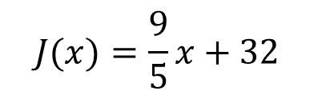
Comparing Equations and Tables (2 of 5)
Xavier uses an equation to convert Joey’s temperatures, and Joey looks at a table to convert Xavier’s temperatures. The equation and part of the table are shown.
Remember…
0°C = 32°F
Joey’s Table
Xavier’s Equation
10 | −12.2
30 | −1.1
50 | 10
75 | 23.9
$$J(x)=\frac{9}{5}x+32$$
Joey's table columns: degrees Fahrenheit (left), degrees Celsius (right)
SE p. 323
26

Slide 27
Comparing Equations and Tables (3 of 5)
Identify quantities in the table and equation. Who is converting from °C to °F, and who is converting from °F to °C? Explain your reasoning.
  Xavier's equation: x is degrees Celsius and J(x) is degrees Fahrenheit, so Xavier converts °C to °F. Joey's table converts °F to °C (50°F = 10°C).
Compare the given characteristics for each function in terms of the quantities.
a. slope b. y-intercept
  a. Joey's slope is about 5/9: each 9°F increase is about a 5°C increase. Xavier's slope is 9/5: each 5°C increase is a 9°F increase.
  b. Joey's y-intercept is about −17.8: 0°F is about −17.8°C. Xavier's y-intercept is 32: 0°C is 32°F.
Think About…
The units of the quantities are
very important.
SE p. 323
27
Notes:
Questions to Support Discourse – Probing:
How could knowing that 0° F = 32° F help you make sense of the representations?
How did you determine the slope from Joey’s table?
How can you tell the y-intercept from each representation?
For this situation, do you think a table or equation is more helpful?
Questions to Support Discourse – Seeing Structure:
What is the relationship between the two rates of change? Why do you think this is the case?

Slide 28
Comparing Equations and Tables (4 of 5)
Let’s summarize our learning from Activity 4.3!
SE p. 323
28
Notes:
Activity 4.3 Summary:
Properties of functions represented in tables and equations can be compared.

Slide 29
Comparing Equations and Tables (5 of 5)
SE p. 323
29
Notes:
Note: This slide is blank for optional use with displaying work.

Slide 30
Activity 4.4
4.4
10–15
30
Notes:
Note: Total time of 10-15 minutes allotted for Activity 4.4.

Slide 31
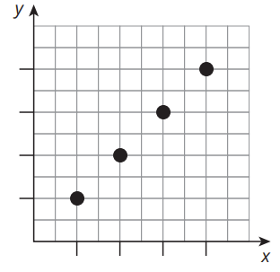
Comparing Descriptions and Graphs (1 of 4)
Lauren and Miguel both opened bank accounts at the same time. Miguel’s account balance is shown in the graph. He started with $0 and deposited the same amount each month. In the 4th month, he had $80 saved. Michelle opened her bank account on September 1st with $25 and continues to deposit $25 each month.
Miguel
Lauren
Lauren opened her bank account on September 1st with $25 and continues to deposit $25 each month.
SE p. 324
31
Notes:
Slide typo: the introduction says 'Michelle opened her bank account'; the person is Lauren.

Slide 32
Comparing Descriptions and Graphs (2 of 4)
Use what you know about Miguel’s account to determine the scale of each axis and interpret the origin on the graph. Explain your reasoning.
  Miguel saves the same amount each month and has $80 after 4 months, so the x-axis ticks are 1 month each and the y-axis ticks are $20 each. The origin is (0 months, $0 saved).
Compare the given characteristics for each function in terms of the quantities.
a. slope b. y-intercept
  a. Miguel's slope is 20: he saves $20 each month. Lauren's slope is 25: she saves $25 each month.
  b. Miguel's y-intercept is 0: he started with $0. Lauren's y-intercept is 25: she started with $25.
Ask Yourself…
How can you
use comparing graphs, tables, and descriptions in everyday life?
SE p. 324
32
Notes:
Questions to Support Discourse – Probing:
How can you tell the independent quantity and dependent quantity from the scenario?
How did you use the given information to label and scale the axes?
What are the units for each slope?
Did you use the situation or graph to determine Miguel’s savings rate? Explain your method.
How did you identify Lauren’s savings rate?
Which representation is more straightforward in this context? Why?

Slide 33
Comparing Descriptions and Graphs (3 of 4)
Let’s summarize our learning from Activity 4.4!
SE p. 324
33
Notes:
Activity 4.4 Summary:
Properties of functions represented in verbal descriptions and graphs can be compared.

Slide 34
Comparing Descriptions and Graphs (4 of 4)
SE p. 324
34
Notes:
Note: This slide is blank for optional use with displaying work.

Slide 35
Talk the Talk
10–15
35
Notes:
Note: Total time of 10-15 minutes allotted for the Talk the Talk.

Slide 36
Function Maker Space (1 of 4)
Consider the table of values.
x | −10 | 10 | 20 | 25
y | 0 | 5 | 7.5 | 8.75
Create a situation to represent the table of values shown.
Write an equation that has a slope that is less steep than the relationship in the table.
  Sample: Alejandra has read 2.5 pages of a book and reads 2.5 more pages every 10 minutes (x = minutes from now, y = pages read). The slope is 1/4.
  Sample: y = 0.2x + 30 (slope 0.2 < 0.25)
SE p. 325
36
Notes:
Questions to Support Discourse – Probing:
What information did you derive from the table to create your situation?
Does your situation model a linear relationship?
Does your situation model an increasing or decreasing function?
How does your situation encompass the entire domain?
Did you change the sign of the slope? Why or why not?
How did you determine the slope of the graphed line?
Questions to Support Discourse – Seeing Structure:
Can you tell whether a slope is increasing or decreasing more easily from a table or graph?
What is the advantage of calculating the slope of a line from a table?
TE wording slip: the TE's sample says Alejandra is 'at the middle of page 2'. Having read 2.5 pages puts her in the middle of page 3, so the situation here says 'has read 2.5 pages'.

Slide 37
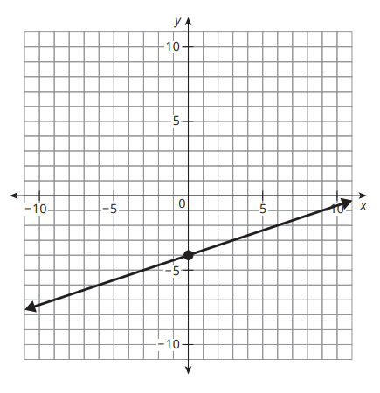
Function Maker Space (2 of 4)
How does the slope of the graph shown compare to the slope from the table of values and your equation?
  Sample: the graphed line has slope 1/3 ≈ 0.333 (through (0, −4) and (3, −3)). It is steeper than the table (1/4) and my equation (0.2).
What strategies did you use to create your linear functions and to compare the slopes?
  Answers will vary: for example, finding the rate of change from two points and comparing the absolute values of the slopes.
SE p. 325
37
Notes:
Questions to Support Discourse – Probing:
What information did you derive from the table to create your situation?
Does your situation model a linear relationship?
Does your situation model an increasing or decreasing function?
How does your situation encompass the entire domain?
Did you change the sign of the slope? Why or why not?
How did you determine the slope of the graphed line?
Questions to Support Discourse – Seeing Structure:
Can you tell whether a slope is increasing or decreasing more easily from a table or graph?
What is the advantage of calculating the slope of a line from a table?

Slide 38
Function Maker Space (3 of 4)
Let’s answer the Essential Question and summarize our learning from the Talk the Talk!
Essential Question: How does each linear function representation compare with the others?
SE p. 325
38
Notes:
Note: To close Day 2, have students read and answer the Essential Question and then read the Stamp the Learning summary aloud.
Essential Question:
Sample answer: You can represent a linear function using an equation, a table, a graph, or a verbal description. You can understand characteristics of linear functions, such as slope, y-intercepts, and independent and dependent quantities from different representations of functions.
Talk the Talk Summary:
A variety of strategies can be used to compare linear functions presented in different representations.

Slide 39
Function Maker Space (4 of 4)
SE p. 325
39
Notes:
Note: This slide is blank for optional use with displaying work.

Slide 40
Teacher Edition notes for this deck
• Slide typo: slide 31 calls Lauren 'Michelle'.
• Talk the Talk Q1: the TE's sample starts Alejandra 'at the middle of page 2'; y = 2.5 pages read is the middle of page 3.
• Every TE answer was re-solved and is correct, including the Assignment (pp. 327-330) and Prepare.
40

Slide 41
Prepare
41
Notes:
How can you identify whether students are ready for new learning? ​
Depending on available time, you can assign the Prepare section of the Lesson Assignments as homework or as a warm-up to identify students' prior knowledge for the upcoming lesson's activities.

Slide 42
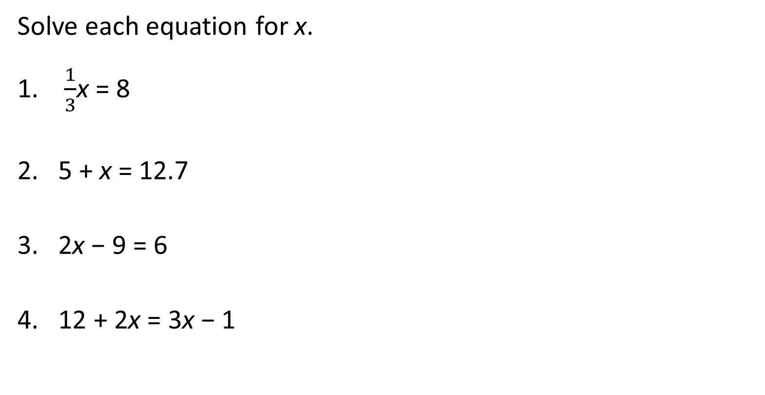
Prepare for Module 3 Topic 1 Lesson 1
Solve each equation for x.
$\frac{1}{3}$x = 8
  x = 24
5 + x = 12.7
  x = 7.7
2x − 9 = 6
  x = 7.5
12 + 2x = 3x − 1
  x = 13
SE p. 330
42

Slide 43
Acknowledgment and Notice
43

Slide 44
BLMATH_AlgI_M2_T2_L4_DCS_ENG
44

